Slide 1
Write the date and objective in your notebook.
Match the symbols on your handout with the descriptions below. Write each description next to the picture on your paper.
Animal safety
Biological hazard
Chemical hazard
Clothing protection safety
Disposal alert
Electrical safety
Explosion safety
Eye safety
Fire safety
Fume safety
Heat alert
Open flame alert
Poison safety
Radioactive safety
Sharp object safety
Skin protection safety
5:00
4:54
4:58
4:59
4:57
4:51
4:55
4:56
4:53
4:49
4:50
4:52
4:42
4:47
4:45
4:46
4:40
4:41
4:44
4:43
4:26
4:27
4:28
4:29
4:31
4:32
4:33
4:35
4:36
4:37
4:38
4:39
4:10
4:11
4:12
4:13
4:14
4:15
4:16
4:17
4:18
4:19
4:20
4:21
4:22
4:23
4:24
4:25
4:01
4:02
4:03
4:04
4:06
4:07
4:09
4:48
4:34
4:30
4:08
4:05

Slide 2
Write the date and objective in your notebook.
Match the symbols on your handout with the descriptions below. Write each description next to the picture on your paper.
Animal safety
Biological hazard
Chemical hazard
Clothing protection safety
Disposal alert
Electrical safety
Explosion safety
Eye safety
Fire safety
Fume safety
Heat alert
Open flame alert
Poison safety
Radioactive safety
Sharp object safety
Skin protection safety
4:00
3:54
3:58
3:59
3:57
3:51
3:55
3:56
3:53
3:49
3:50
3:52
3:42
3:47
3:45
3:46
3:40
3:41
3:44
3:43
3:26
3:27
3:28
3:29
3:31
3:32
3:33
3:35
3:36
3:37
3:38
3:39
3:10
3:11
3:12
3:13
3:14
3:15
3:16
3:17
3:18
3:19
3:20
3:21
3:22
3:23
3:24
3:25
3:01
3:02
3:03
3:04
3:06
3:07
3:09
3:48
3:34
3:30
3:08
3:05

Slide 3
Write the date and objective in your notebook.
Match the symbols on your handout with the descriptions below. Write each description next to the picture on your paper.
Animal safety
Biological hazard
Chemical hazard
Clothing protection safety
Disposal alert
Electrical safety
Explosion safety
Eye safety
Fire safety
Fume safety
Heat alert
Open flame alert
Poison safety
Radioactive safety
Sharp object safety
Skin protection safety
3:00
2:54
2:58
2:59
2:57
2:51
2:55
2:56
2:53
2:49
2:50
2:52
2:42
2:47
2:45
2:46
2:40
2:41
2:44
2:43
2:26
2:27
2:28
2:29
2:31
2:32
2:33
2:35
2:36
2:37
2:38
2:39
2:10
2:11
2:12
2:13
2:14
2:15
2:16
2:17
2:18
2:19
2:20
2:21
2:22
2:23
2:24
2:25
2:01
2:02
2:03
2:04
2:06
2:07
2:09
2:48
2:34
2:30
2:08
2:05

Slide 4
Write the date and objective in your notebook.
Match the symbols on your handout with the descriptions below. Write each description next to the picture on your paper.
Animal safety
Biological hazard
Chemical hazard
Clothing protection safety
Disposal alert
Electrical safety
Explosion safety
Eye safety
Fire safety
Fume safety
Heat alert
Open flame alert
Poison safety
Radioactive safety
Sharp object safety
Skin protection safety
2:00
1:54
1:58
1:59
1:57
1:51
1:55
1:56
1:53
1:49
1:50
1:52
1:42
1:47
1:45
1:46
1:40
1:41
1:44
1:43
1:26
1:27
1:28
1:29
1:31
1:32
1:33
1:35
1:36
1:37
1:38
1:39
1:10
1:11
1:12
1:13
1:14
1:15
1:16
1:17
1:18
1:19
1:20
1:21
1:22
1:23
1:24
1:25
1:01
1:02
1:03
1:04
1:06
1:07
1:09
1:48
1:34
1:30
1:08
1:05

Slide 5
Write the date and objective in your notebook.
Match the symbols on your handout with the descriptions below. Write each description next to the picture on your paper.
TIME IS UP!
Animal safety
Biological hazard
Chemical hazard
Clothing protection safety
Disposal alert
Electrical safety
Explosion safety
Eye safety
Fire safety
Fume safety
Heat alert
Open flame alert
Poison safety
Radioactive safety
Sharp object safety
Skin protection safety
1:00
:54
:58
:59
:57
:51
:55
:56
:53
:49
:50
:52
:42
:47
:45
:46
:40
:41
:44
:43
:26
:27
:28
:29
:31
:32
:33
:35
:36
:37
:38
:39
:10
:11
:12
:13
:14
:15
:16
:17
:18
:19
:20
:21
:22
:23
:24
:25
:01
:02
:03
:04
:06
:07
:09
:48
:34
:30
:08
:05

Slide 6
Today’s Objectives
Define and identify examples of flammability, corrosiveness, and radioactivity.
Use a Material Safety Data Sheet (MSDS) to answer safety questions about specific chemicals.

Slide 7
3 New Vocabulary Words:
Flammability
Corrosiveness
Reactivity

Slide 8

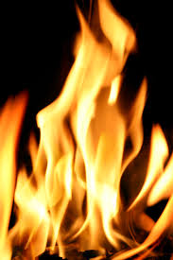


Flammability:
How easily something will burn or catch on fire
Example: paper is very flammable
OPEN FLAME ALERT FIRE SAFETY

Slide 9

Corrosiveness:
How good a substance is at destroying or eating away another substance
Examples: acids and bases are very corrosive
http://www.youtube.com/watch?v=F5jfRjzXLbE

Slide 10
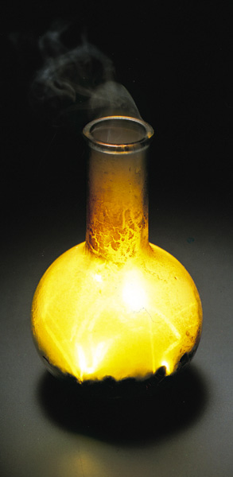
Reactivity:
How likely a substance is to participate in a chemical reaction
Example: Sodium by itself is very reactive (explosive)
http://www.youtube.com/watch?v=7Xu2YZzufTM

Slide 11
Material Safety Data Sheet (MSDS)
Document with information about potential dangers and how to work safely with a chemical

Slide 12
MSDS Sections
Chemical Product and Company Identification
Composition, Information on Ingredients
Hazards Identification
First Aid Measures
Fire Fighting Measures
Accidental Release Measures (SPILLS)
Handling and Storage
Exposure Controls, Personal Protection
Physical and Chemical Properties

Slide 13
MSDS At-A-Glance: Acetone
FLINN AT-A-GLANCE
Health-1
Flammability-3
Reactivity-2
Exposure-1
Storage-3
0 = Not dangerous
1 = Slightly dangerous
2 = Moderately dangerous
3 = Most dangerous

