Slide 1

Warm Up:
Name one physical property of Drake’s jacket
Name one chemical property of Drake’s jacket
5:00
4:54
4:58
4:59
4:57
4:51
4:55
4:56
4:53
4:49
4:50
4:52
4:42
4:47
4:45
4:46
4:40
4:41
4:44
4:43
4:26
4:27
4:28
4:29
4:31
4:32
4:33
4:35
4:36
4:37
4:38
4:39
4:10
4:11
4:12
4:13
4:14
4:15
4:16
4:17
4:18
4:19
4:20
4:21
4:22
4:23
4:24
4:25
4:01
4:02
4:03
4:04
4:06
4:07
4:09
4:48
4:34
4:30
4:08
4:05

Slide 2
Warm Up:
Name one physical property of Drake’s jacket
Name one chemical property of Drake’s jacket
4:00
3:54
3:58
3:59
3:57
3:51
3:55
3:56
3:53
3:49
3:50
3:52
3:42
3:47
3:45
3:46
3:40
3:41
3:44
3:43
3:26
3:27
3:28
3:29
3:31
3:32
3:33
3:35
3:36
3:37
3:38
3:39
3:10
3:11
3:12
3:13
3:14
3:15
3:16
3:17
3:18
3:19
3:20
3:21
3:22
3:23
3:24
3:25
3:01
3:02
3:03
3:04
3:06
3:07
3:09
3:48
3:34
3:30
3:08
3:05

Slide 3
Warm Up:
Name one physical property of Drake’s jacket
Name one chemical property of Drake’s jacket
3:00
2:54
2:58
2:59
2:57
2:51
2:55
2:56
2:53
2:49
2:50
2:52
2:42
2:47
2:45
2:46
2:40
2:41
2:44
2:43
2:26
2:27
2:28
2:29
2:31
2:32
2:33
2:35
2:36
2:37
2:38
2:39
2:10
2:11
2:12
2:13
2:14
2:15
2:16
2:17
2:18
2:19
2:20
2:21
2:22
2:23
2:24
2:25
2:01
2:02
2:03
2:04
2:06
2:07
2:09
2:48
2:34
2:30
2:08
2:05

Slide 4
Warm Up:
Name one physical property of Drake’s jacket
Name one chemical property of Drake’s jacket
2:00
1:54
1:58
1:59
1:57
1:51
1:55
1:56
1:53
1:49
1:50
1:52
1:42
1:47
1:45
1:46
1:40
1:41
1:44
1:43
1:26
1:27
1:28
1:29
1:31
1:32
1:33
1:35
1:36
1:37
1:38
1:39
1:10
1:11
1:12
1:13
1:14
1:15
1:16
1:17
1:18
1:19
1:20
1:21
1:22
1:23
1:24
1:25
1:01
1:02
1:03
1:04
1:06
1:07
1:09
1:48
1:34
1:30
1:08
1:05

Slide 5
Warm Up:
Name one physical property of Drake’s jacket
Name one chemical property of Drake’s jacket
TIME IS UP!
1:00
:54
:58
:59
:57
:51
:55
:56
:53
:49
:50
:52
:42
:47
:45
:46
:40
:41
:44
:43
:26
:27
:28
:29
:31
:32
:33
:35
:36
:37
:38
:39
:10
:11
:12
:13
:14
:15
:16
:17
:18
:19
:20
:21
:22
:23
:24
:25
:01
:02
:03
:04
:06
:07
:09
:48
:34
:30
:08
:05

Slide 6
ESSENTIAL QUESTION:
Is this the same substance or a new substance?
Same Substance
New Substance
Chemical Property
Physical Property

Slide 7
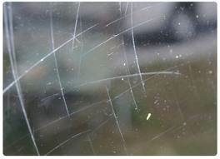
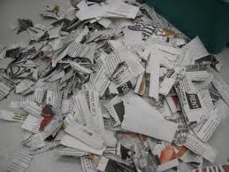
Physical Change
Changes a substance’s appearance but NOT its composition (what it’s made of)
  Usually easily reversible
    Do this by using separation of mixtures techniques!
Examples:
  Ripping paper
  Scratching glass
  Melting ice

Slide 8


Chemical Change
When you actually CHANGE the composition of a substance
Examples:
  Bleaching hair
  Fireworks exploding

Slide 9
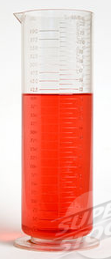
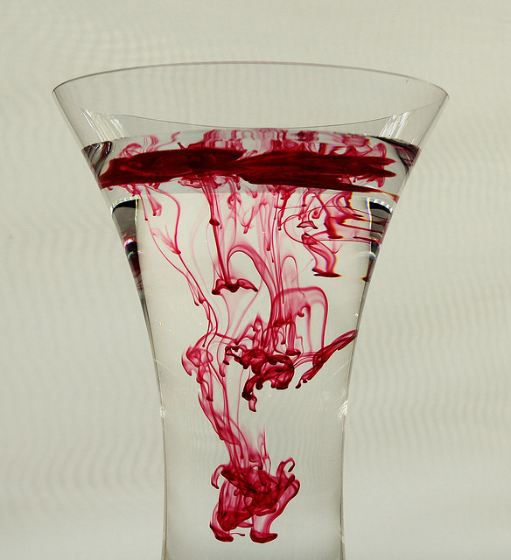
Physical Change Clues
Phase change (solid, liquid, gas)
No new substance created
Shape change
Size change
Predictable color change (clear water + red food coloring = pink)

Slide 10
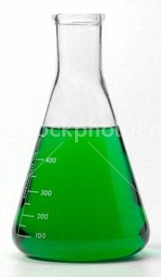
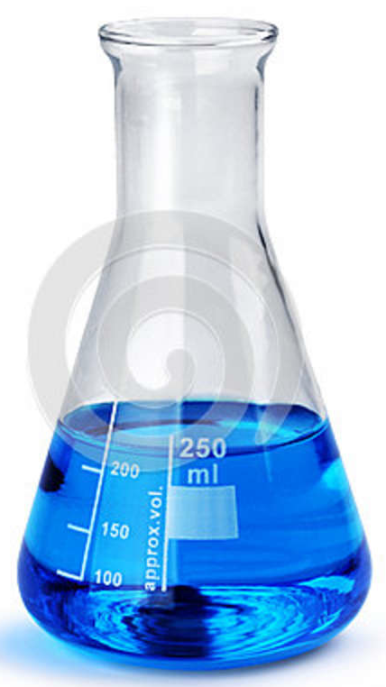
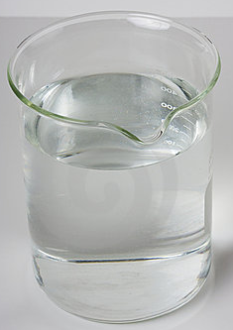
Chemical Change Clues
1. Unpredictable and/or permanent color change
Unpredictable Color Change:

Slide 11
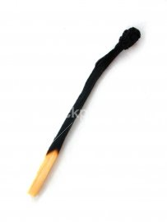
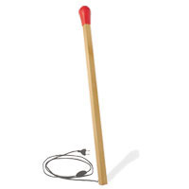
Chemical Change Clues
1. Unpredictable and/or permanent color change
Permanent Color Change:
red/brown
black

Slide 12
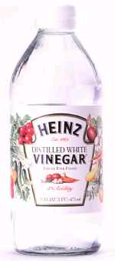
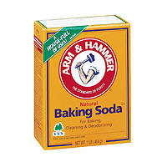
2. A gas is produced (bubbles)
carbon dioxide gas
+
Baking soda Vinegar

Slide 13

3. A new substance is formed
(mold forms)

Slide 14
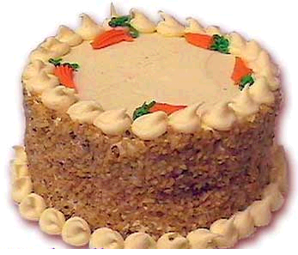
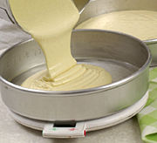
4. The change is not reversible

Slide 15

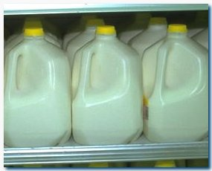
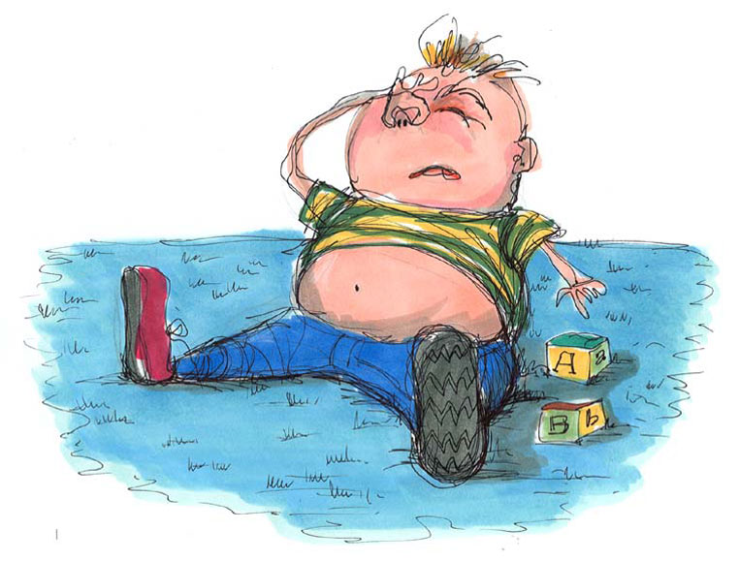
5. A smell is produced
Gross!
1 month old

Slide 16
6. Unpredictable Temperature Change

Slide 17
RAPIDFIRE QUESTIONS:
Decide whether each change is chemical or physical. 5 minutes.
Salt is dissolved in water
Iron rusts in a damp environment
Gasoline burns in the presence of oxygen
Dry ice changes from solid to gas at room temperature
Hydrogen peroxide decomposes into water and oxygen

Slide 18
MINI LAB!
Chemical and Physical Changes
Goggles and lab coats!
5 stations
At each station, follow directions and observe whether each change is chemical or physical
Answer each station’s questions in your packet
Stay with your group at all times

Slide 19
STATIONS
Hydrochloric acid (HCl) and Magnesium (Mg)
Magnesium sulfate (MgSO₄) and water
Calcium carbonate (CaCO₃)
Food coloring
Starch and iodine

Slide 20
CLEANUP
Where Chemicals Go:
Hydrochloric acid | Beaker on demo desk
Magnesium ribbon | Trash
Magnesium sulfate | Trash
Calcium carbonate | Trash
Food coloring | Sink
Starch | Trash
Iodine | Sink
***Wipe desk with Lysol and paper towels***

Slide 21
Station 1: Hydrochloric acid and Magnesium
Materials: Small strip of Magnesium Plastic pipette Rubber Gloves Test Tube Hydrochloric acid
Warnings: You must wear gloves when working with HCl. Skin Contact: Immediately flush skin with plenty of water for at least 15 minutes while removing contaminated clothing and shoes. Get medical attention immediately. Wash clothing before reuse. Thoroughly clean shoes before reuse. Eye Contact: Immediately flush eyes with plenty of water for at least 15 minutes, lifting lower and upper eyelids occasionally. Get medical attention immediately.
Procedure: Use the plastic pipette to transfer approximately 50 ml (a few centimeters) HCl into the test tube Drop the strip of Magnesium into test tube with HCl Observe.

Slide 22
Station 2: Magnesium sulfate and water
Materials: Beaker with water Test tube Water Magnesium sulfate Scoopula
Warnings: Magnesium sulfate harmful if swallowed.
Procedure: Use the scoopula to add a small amount of Magnesium sulfate to the test tube Add water until the test tube is 1/3 full Use the scoopula to stir vigorously Stir until all the Magnesium sulfate is dissolved

Slide 23
Station 3: Calcium carbonate
Materials Stick of Calcium carbonate Mortar and pestle
Warnings: Calcium carbonate is dangerous if ingested.
Procedure: Observe the Calcium carbonate and write your description below Place a stick of Calcium carbonate into the mortar and pestle (2-3 cm) Use the pestle to grind the particles until they are dust Observe

Slide 24
Station 4: Food Coloring
Materials Three test tubes Water Stirring rod Food coloring
Warnings: Don't drop the food coloring on the desk or your clothes – it can stain them permanently.
Procedure: Fill two test tubes halfway with water Add one drop of food coloring to each beaker (different colors) Pour both test tubes into the third test tube

Slide 25
Station 5: Starch and Iodine
Materials: Test tube Iodine Cornstarch solution 2 plastic pipettes Scoopula
Warnings: Iodine is dangerous if swallowed. Never consume food in the lab.
Procedure: Use a plastic pipette to place a small amount of cornstarch solution into the test tube Use the other plastic pipette to drop 3 drops of iodine into the test tube Observe all changes and write descriptions below

