Slide 1
Do Now:
Get out your HW (the phase changes foldable)
Write down today’s date and objective in your notebook
True or false:
    Condensation = substance changing from gas to liquid
    You can’t turn gold into a gas no matter how hard you try
    Gas particles are closer together than liquid particles
5:00
4:54
4:58
4:59
4:57
4:51
4:55
4:56
4:53
4:49
4:50
4:52
4:42
4:47
4:45
4:46
4:40
4:41
4:44
4:43
4:26
4:27
4:28
4:29
4:31
4:32
4:33
4:35
4:36
4:37
4:38
4:39
4:10
4:11
4:12
4:13
4:14
4:15
4:16
4:17
4:18
4:19
4:20
4:21
4:22
4:23
4:24
4:25
4:01
4:02
4:03
4:04
4:06
4:07
4:09
4:48
4:34
4:30
4:08
Objectives: SWBAT describe phase changes.
SWBAT predict states of matter using graphs.
4:05

Slide 2
Do Now:
Get out your HW (the phase changes foldable)
Write down today’s date and objectives in your notebook
True or false:
    Condensation = substance changing from gas to liquid
    You can’t turn gold into a gas no matter how hard you try
    Gas particles are closer together than liquid particles
Do Now:
LEARN!
4:00
3:54
3:58
3:59
3:57
3:51
3:55
3:56
3:53
3:49
3:50
3:52
3:42
3:47
3:45
3:46
3:40
3:41
3:44
3:43
3:26
3:27
3:28
3:29
3:31
3:32
3:33
3:35
3:36
3:37
3:38
3:39
3:10
3:11
3:12
3:13
3:14
3:15
3:16
3:17
3:18
3:19
3:20
3:21
3:22
3:23
3:24
3:25
3:01
3:02
3:03
3:04
3:06
3:07
3:09
3:48
3:34
3:30
3:08
Objectives: SWBAT describe phase changes.
SWBAT predict states of matter using graphs.
3:05

Slide 3
Do Now:
Get out your HW (the phase changes foldable)
Write down today’s date and objective in your notebook
True or false:
    Condensation = substance changing from gas to liquid
    You can’t turn gold into a gas no matter how hard you try
    Gas particles are closer together than liquid particles
Do Now:
LEARN!
3:00
2:54
2:58
2:59
2:57
2:51
2:55
2:56
2:53
2:49
2:50
2:52
2:42
2:47
2:45
2:46
2:40
2:41
2:44
2:43
2:26
2:27
2:28
2:29
2:31
2:32
2:33
2:35
2:36
2:37
2:38
2:39
2:10
2:11
2:12
2:13
2:14
2:15
2:16
2:17
2:18
2:19
2:20
2:21
2:22
2:23
2:24
2:25
2:01
2:02
2:03
2:04
2:06
2:07
2:09
2:48
2:34
2:30
2:08
2:05
Objectives: SWBAT describe phase changes.
SWBAT predict states of matter using graphs.

Slide 4
Do Now:
Get out your HW (the phase changes foldable)
Write down today’s date and objective in your notebook
True or false:
    Condensation = substance changing from gas to liquid
    You can’t turn gold into a gas no matter how hard you try
    Gas particles are closer together than liquid particles
Do Now:
LEARN!
2:00
1:54
1:58
1:59
1:57
1:51
1:55
1:56
1:53
1:49
1:50
1:52
1:42
1:47
1:45
1:46
1:40
1:41
1:44
1:43
1:26
1:27
1:28
1:29
1:31
1:32
1:33
1:35
1:36
1:37
1:38
1:39
1:10
1:11
1:12
1:13
1:14
1:15
1:16
1:17
1:18
1:19
1:20
1:21
1:22
1:23
1:24
1:25
1:01
1:02
1:03
1:04
1:06
1:07
1:09
1:48
1:34
1:30
1:08
1:05
Objectives: SWBAT describe phase changes.
SWBAT predict states of matter using graphs.

Slide 5
Do Now:
Get out your HW (the phase changes foldable)
Write down today’s date and objective in your notebook
True or false:
    Condensation = substance changing from gas to liquid
    You can’t turn gold into a gas no matter how hard you try
    Gas particles are closer together than liquid particles
Do Now:
LEARN!
TIME IS UP!
1:00
:54
:58
:59
:57
:51
:55
:56
:53
:49
:50
:52
:42
:47
:45
:46
:40
:41
:44
:43
:26
:27
:28
:29
:31
:32
:33
:35
:36
:37
:38
:39
:10
:11
:12
:13
:14
:15
:16
:17
:18
:19
:20
:21
:22
:23
:24
:25
:01
:02
:03
:04
:06
:07
:09
:48
:34
:30
:08
:05
Objectives: SWBAT describe phase changes.
SWBAT predict states of matter using graphs.

Slide 6
Do Now:
True or false:
  Condensation = substance changing from gas to liquid
  You can’t turn gold into a gas no matter how hard you try
  Gas particles are closer together than liquid particles
TRUE!
FALSE!
FALSE!

Slide 7
Unit 2 Quiz 2 Grades
1
2
3

Slide 8
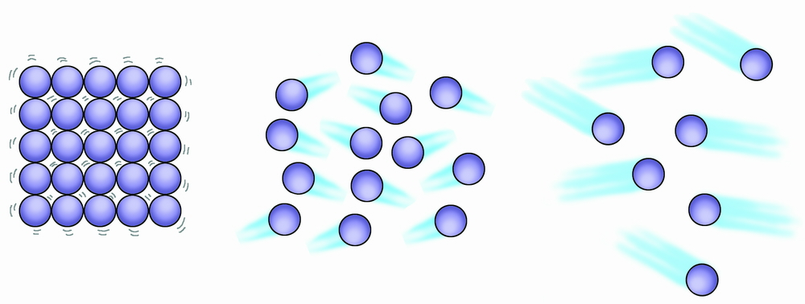
Phase
Whether something is in solid, liquid, or gas form
  EVERYTHING can exist in either solid, liquid, or gas form
  The phase all depends on the temperature
SOLID
LIQUID
GAS
Notes:
Slide contains animation

Slide 9
Phase Change
When something changes from one phase (state of matter) to another.
Particles either speed up or slow down
Particles either get farther apart or closer together
Energy (heat) is either REQUIRED or RELEASED
SOLID
Particles speeding up and getting farther apart
LIQUID
GAS
Particles speeding up and getting farther apart
Notes:
Slide contains animation

Slide 10
Melting Point
The temperature at which a solid turns into a liquid
Same as freezing point
Water’s melting point = 0 degrees Celsius
Notes:
Slide contains animation

Slide 11
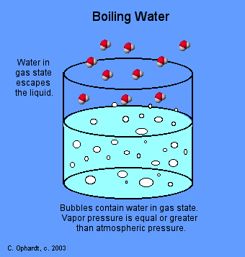
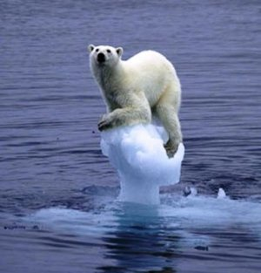
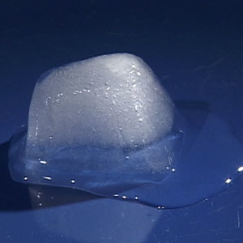
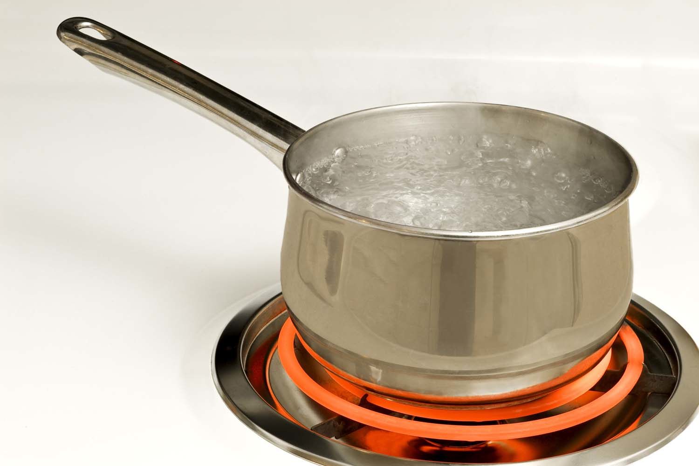
Boiling Point
The temperature at which a liquid turns into a gas
Water’s boiling point = 100 degrees Celsius
Notes:
Slide contains animation

Slide 12
As you breathe on a mirror, a film of water briefly forms on the mirror

Slide 13
A puddle dries up on a sunny day

Slide 14
Water droplets form on the outside of your iced coffee

Slide 15
Snow forms from clouds

Slide 16

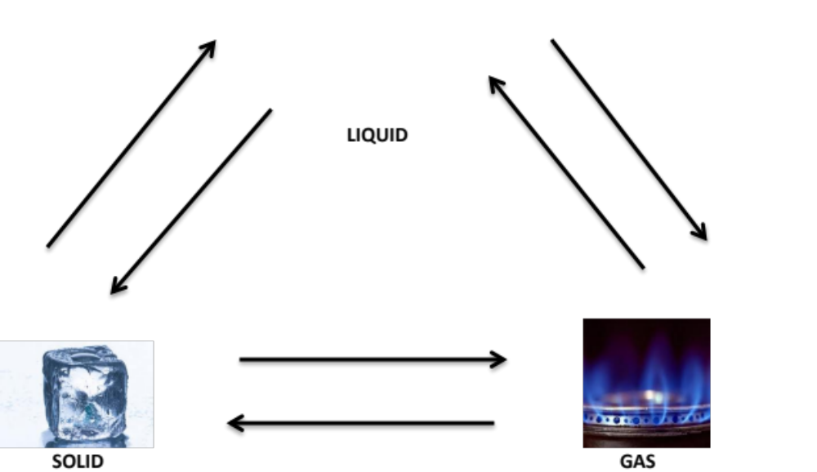
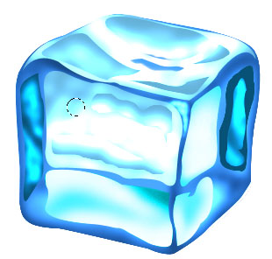

Melting
LIQUID
Freezing
SOLID
GAS

Slide 17
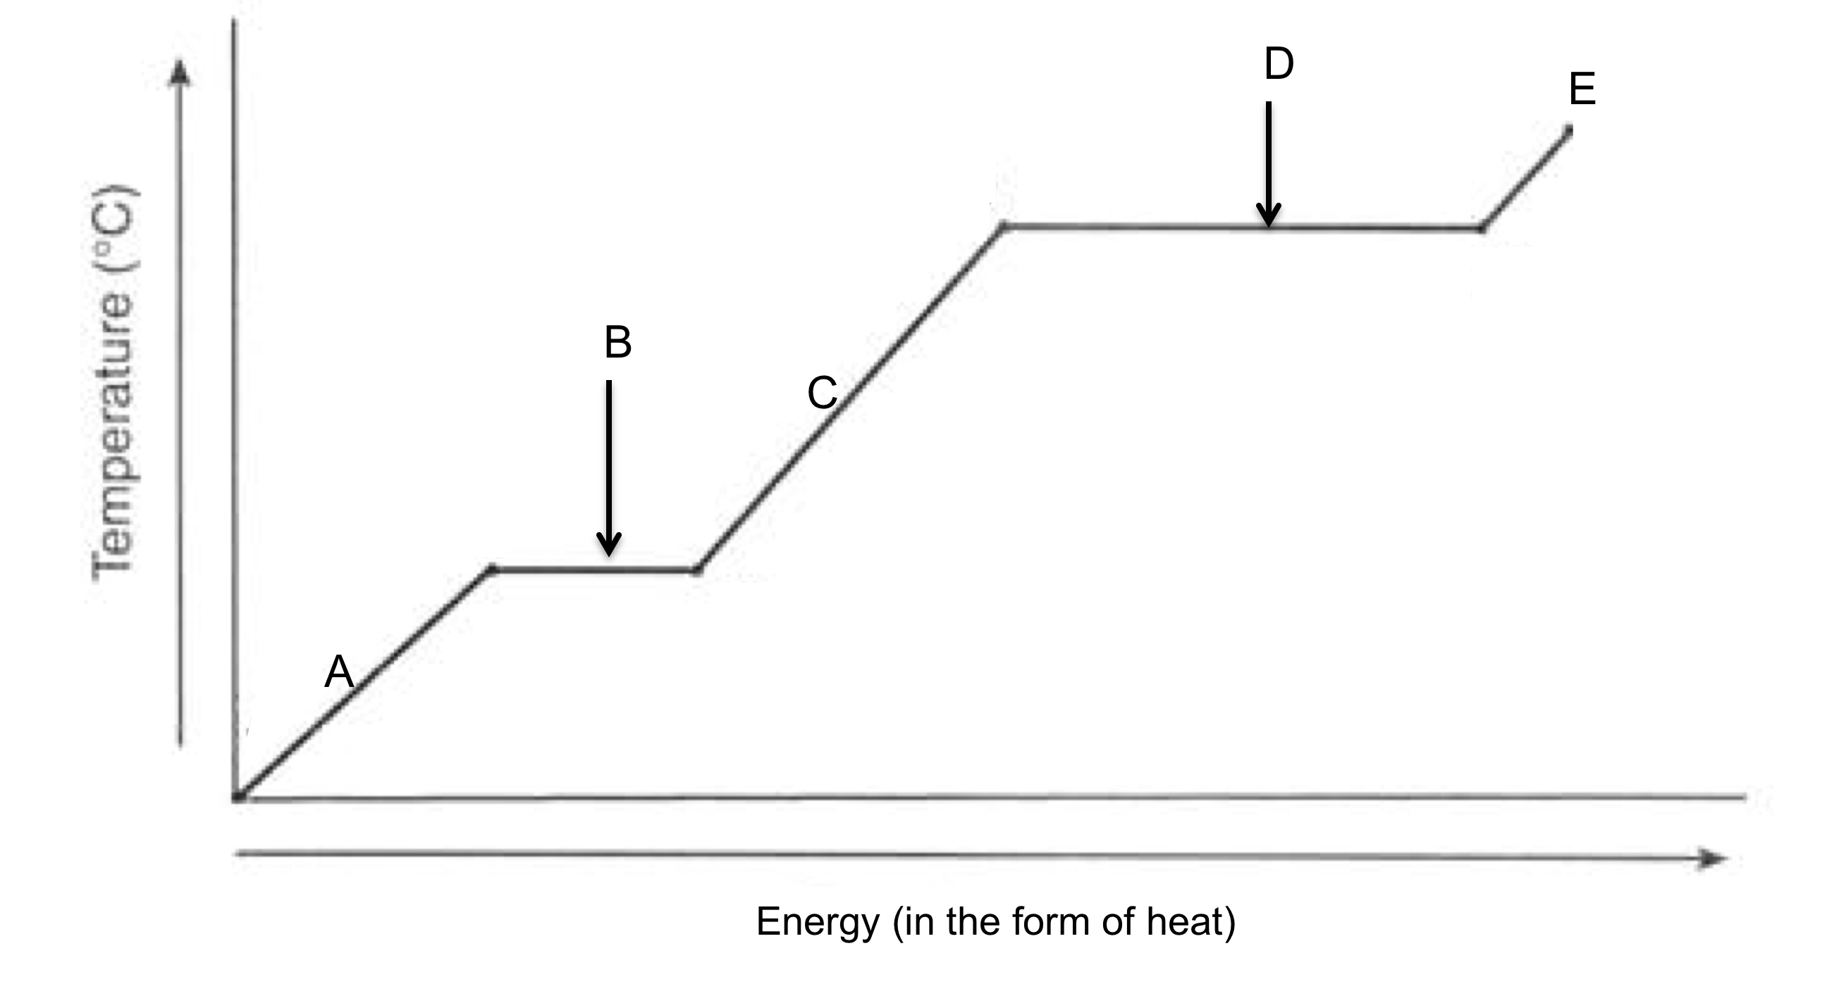

Slide 18
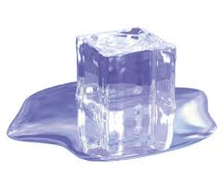
MELTING
Equation
Solid → liquid.
Example
      Ice cube to liquid water
Notes:
Slide contains animation.

Slide 19
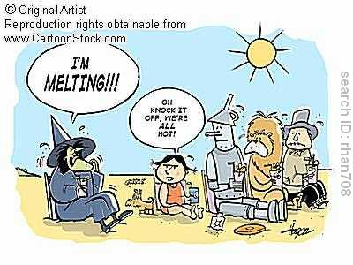

Slide 20
FREEZING
Equation
Liquid → Solid
Example:
    Liquid water to ice

Slide 21
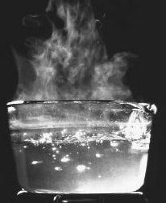
VAPORIZATION
Equation
Liquid → gas
Example:
  Boiling water to change the liquid to gas
Notes:
Slide contains animation.

Slide 22

CONDENSATION
Equation
Gas → liquid
Example
      Water vapor to liquid water
Notes:
Slide contains animation.

Slide 23
SUBLIMATION
Equation
Solid → gas (skipping liquid phase)
Example
    Dry ice
Notes:
Slide contains animation.

Slide 24
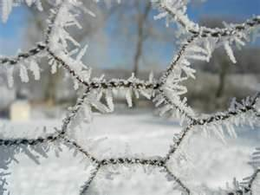
Deposition
Equation
Gas → solid
Example: frost forming on a fence
Notes:
Slide contains animation.

Slide 25
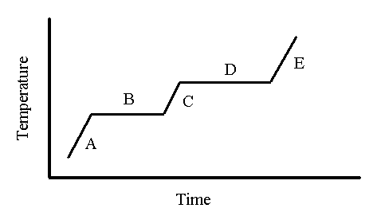
Phase Diagram! – a relationship between temperature and energy/heat that shows how energy affects the phase of a substance
Gas
liquid
Solid
Energy (kJ)

Slide 26
Phase Diagram! – a relationship between temperature and energy/heat that shows how energy affects the phase of a substance
Gas
Vaporization
Melting
liquid
Condensation
Solid
Freezing
Energy (kJ)

Slide 27
Phase Diagram! – a relationship between temperature and energy/heat that shows how energy affects the phase of a substance
Boiling Point (BP)
Gas
Vaporization
Melting
liquid
Melting Point (MP)
Condensation
Solid
Freezing
Energy (kJ)

