Slide 1
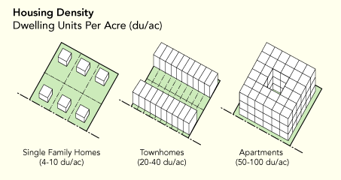
Do Now:
Take out last night’s HW
Write down today’s objective in your notebook
The picture below shows three different blocks. Which block is most densely populated? Draw a picture of the least dense and most dense blocks in your notebook.
5:00
4:54
4:58
4:59
4:57
4:51
4:55
4:56
4:53
4:49
4:50
4:52
4:42
4:47
4:45
4:46
4:40
4:41
4:44
4:43
4:26
4:27
4:28
4:29
4:31
4:32
4:33
4:35
4:36
4:37
4:38
4:39
4:10
4:11
4:12
4:13
4:14
4:15
4:16
4:17
4:18
4:19
4:20
4:21
4:22
4:23
4:24
4:25
4:01
4:02
4:03
4:04
4:06
4:07
4:09
4:48
4:34
4:30
4:08
4:05

Slide 2
Do Now:
Take out last night’s HW
Write down today’s objective in your notebook
The picture below shows three different blocks. Which block is most densely populated? Draw a picture of the least dense and most dense blocks in your notebook.
4:00
3:54
3:58
3:59
3:57
3:51
3:55
3:56
3:53
3:49
3:50
3:52
3:42
3:47
3:45
3:46
3:40
3:41
3:44
3:43
3:26
3:27
3:28
3:29
3:31
3:32
3:33
3:35
3:36
3:37
3:38
3:39
3:10
3:11
3:12
3:13
3:14
3:15
3:16
3:17
3:18
3:19
3:20
3:21
3:22
3:23
3:24
3:25
3:01
3:02
3:03
3:04
3:06
3:07
3:09
3:48
3:34
3:30
3:08
3:05

Slide 3
Do Now:
Take out last night’s HW
Write down today’s objective in your notebook
The picture below shows three different blocks. Which block is most densely populated? Draw a picture of the least dense and most dense blocks in your notebook.
3:00
2:54
2:58
2:59
2:57
2:51
2:55
2:56
2:53
2:49
2:50
2:52
2:42
2:47
2:45
2:46
2:40
2:41
2:44
2:43
2:26
2:27
2:28
2:29
2:31
2:32
2:33
2:35
2:36
2:37
2:38
2:39
2:10
2:11
2:12
2:13
2:14
2:15
2:16
2:17
2:18
2:19
2:20
2:21
2:22
2:23
2:24
2:25
2:01
2:02
2:03
2:04
2:06
2:07
2:09
2:48
2:34
2:30
2:08
2:05

Slide 4
Do Now:
Take out last night’s HW
Write down today’s objective in your notebook
The picture below shows three different blocks. Which block is most densely populated? Draw a picture of the least dense and most dense blocks in your notebook.
2:00
1:54
1:58
1:59
1:57
1:51
1:55
1:56
1:53
1:49
1:50
1:52
1:42
1:47
1:45
1:46
1:40
1:41
1:44
1:43
1:26
1:27
1:28
1:29
1:31
1:32
1:33
1:35
1:36
1:37
1:38
1:39
1:10
1:11
1:12
1:13
1:14
1:15
1:16
1:17
1:18
1:19
1:20
1:21
1:22
1:23
1:24
1:25
1:01
1:02
1:03
1:04
1:06
1:07
1:09
1:48
1:34
1:30
1:08
1:05

Slide 5
Do Now:
Take out last night’s HW
Write down today’s objective in your notebook
The picture below shows three different blocks. Which block is most densely populated? Draw a picture of the least dense and most dense blocks in your notebook.
TIME IS UP!
1:00
:54
:58
:59
:57
:51
:55
:56
:53
:49
:50
:52
:42
:47
:45
:46
:40
:41
:44
:43
:26
:27
:28
:29
:31
:32
:33
:35
:36
:37
:38
:39
:10
:11
:12
:13
:14
:15
:16
:17
:18
:19
:20
:21
:22
:23
:24
:25
:01
:02
:03
:04
:06
:07
:09
:48
:34
:30
:08
:05

Slide 6
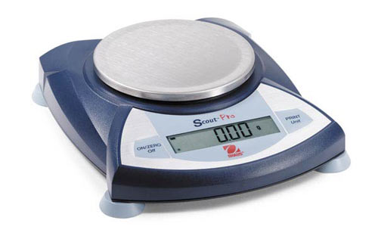
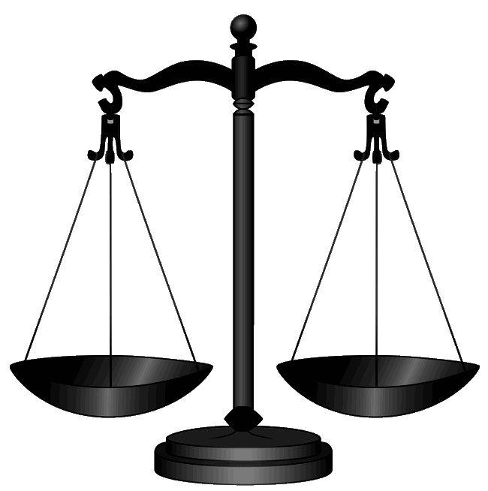
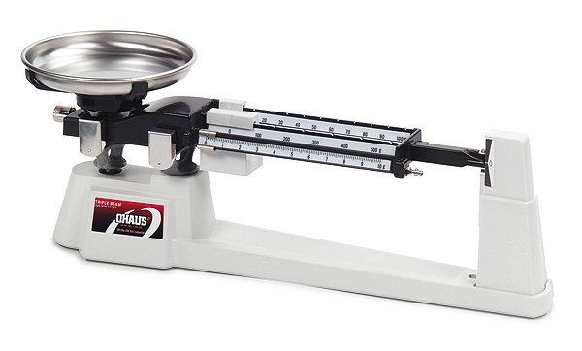
What is Mass?
Definition: The amount of matter in something (how heavy it is due to matter)
Units: grams (g)
How to measure: electronic or triple-beam balance

Slide 7
Arrange the objects in front of you in a line from least mass to most mass.

Slide 8
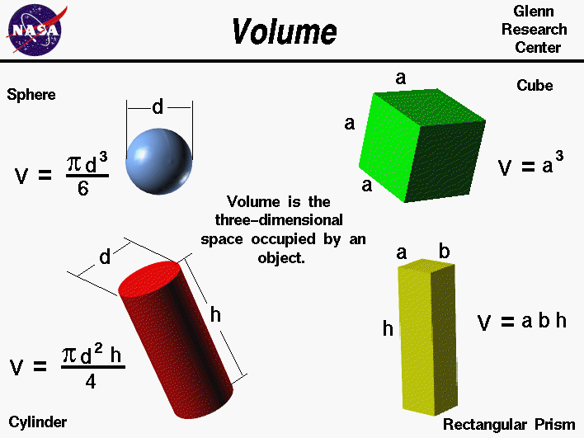

What is Volume?
Definition: The amount of space something takes up
Units:
  LIQUIDS or Irregularly-Shaped Solids: mL
  Regularly-shaped solids: cm³
  IMPORTANT: 1 mL = 1 cm³
Two ways to measure volume

Slide 9
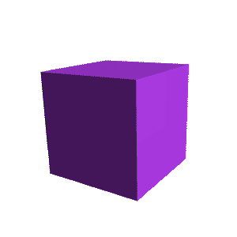
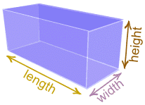
1. Regularly-shaped solids (rectangular box or cube)
Volume = Length x Width x Height

Slide 10
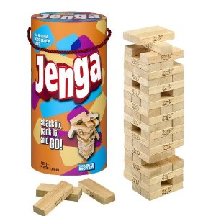
Real Life Example:

Slide 11
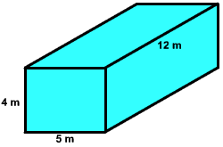
What is the volume of the rectangular box below?

Slide 12
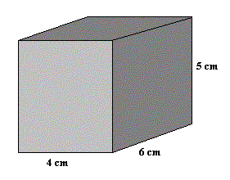
What is the volume of the rectangular box below?

Slide 13
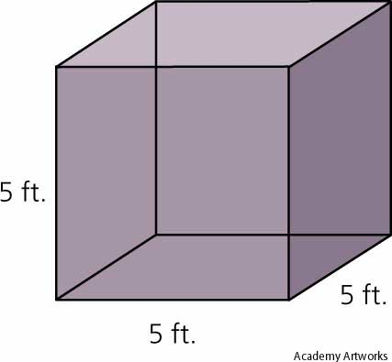
What is the volume of the CUBE below?

Slide 14
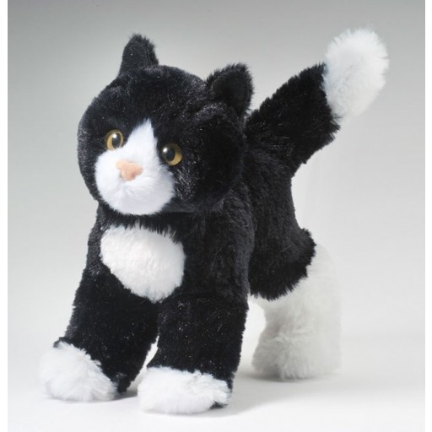
How can we measure the volume of Luna the Cat?

Slide 15
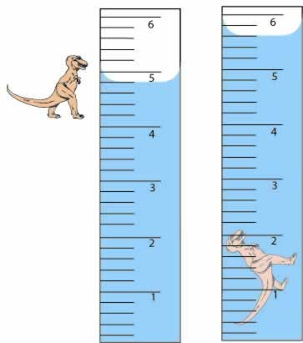
2. Irregularly-shaped solids or any liquid
DISPLACEMENT: Fill a graduated cylinder with a specific amount of water, add the irregularly-shaped solid, and measure the final water level
Final – initial = volume of object

Slide 16
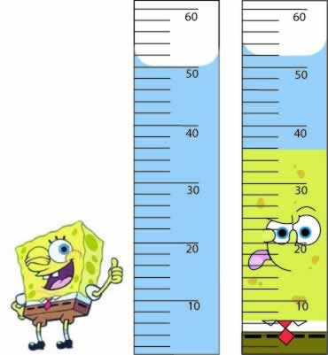
What is the volume of Spongebob?

Slide 17
Practice Problems

Slide 18
What is Density?

Slide 19
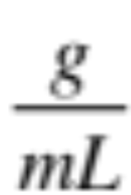
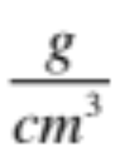
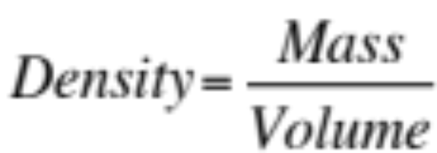
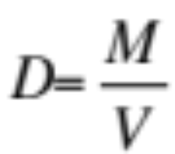
Density
Definition:
  Mass per unit volume
  How tightly packed something’s particles are
Units: or
How to Measure:
or

