Slide 1
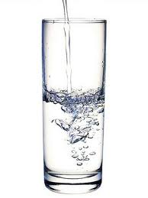
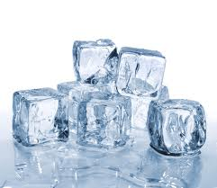
Warm Up:
Compare and contrast the two pictures below. How are the substances the same or different? Do they show the same substance or different substances?
Picture A: Water
Picture B: Ice
5:00
4:54
4:58
4:59
4:57
4:51
4:55
4:56
4:53
4:49
4:50
4:52
4:42
4:47
4:45
4:46
4:40
4:41
4:44
4:43
4:26
4:27
4:28
4:29
4:31
4:32
4:33
4:35
4:36
4:37
4:38
4:39
4:10
4:11
4:12
4:13
4:14
4:15
4:16
4:17
4:18
4:19
4:20
4:21
4:22
4:23
4:24
4:25
4:01
4:02
4:03
4:04
4:06
4:07
4:09
4:48
4:34
4:30
4:08
4:05

Slide 2
Warm Up:
Compare and contrast the two pictures below. How are the substances the same or different? Do they show the same substance or different substances?
Picture A: Water
Picture B: Ice
4:00
3:54
3:58
3:59
3:57
3:51
3:55
3:56
3:53
3:49
3:50
3:52
3:42
3:47
3:45
3:46
3:40
3:41
3:44
3:43
3:26
3:27
3:28
3:29
3:31
3:32
3:33
3:35
3:36
3:37
3:38
3:39
3:10
3:11
3:12
3:13
3:14
3:15
3:16
3:17
3:18
3:19
3:20
3:21
3:22
3:23
3:24
3:25
3:01
3:02
3:03
3:04
3:06
3:07
3:09
3:48
3:34
3:30
3:08
3:05

Slide 3
Warm Up:
Compare and contrast the two pictures below. How are the substances the same or different? Do they show the same substance or different substances?
Picture A: Water
Picture B: Ice
3:00
2:54
2:58
2:59
2:57
2:51
2:55
2:56
2:53
2:49
2:50
2:52
2:42
2:47
2:45
2:46
2:40
2:41
2:44
2:43
2:26
2:27
2:28
2:29
2:31
2:32
2:33
2:35
2:36
2:37
2:38
2:39
2:10
2:11
2:12
2:13
2:14
2:15
2:16
2:17
2:18
2:19
2:20
2:21
2:22
2:23
2:24
2:25
2:01
2:02
2:03
2:04
2:06
2:07
2:09
2:48
2:34
2:30
2:08
2:05

Slide 4
Warm Up:
Compare and contrast the two pictures below. How are the substances the same or different? Do they show the same substance or different substances?
Picture A: Water
Picture B: Ice
2:00
1:54
1:58
1:59
1:57
1:51
1:55
1:56
1:53
1:49
1:50
1:52
1:42
1:47
1:45
1:46
1:40
1:41
1:44
1:43
1:26
1:27
1:28
1:29
1:31
1:32
1:33
1:35
1:36
1:37
1:38
1:39
1:10
1:11
1:12
1:13
1:14
1:15
1:16
1:17
1:18
1:19
1:20
1:21
1:22
1:23
1:24
1:25
1:01
1:02
1:03
1:04
1:06
1:07
1:09
1:48
1:34
1:30
1:08
1:05

Slide 5
Warm Up:
Compare and contrast the two pictures below. How are the substances the same or different? Do they show the same substance or different substances?
TIME IS UP!
Picture A: Water
Picture B: Ice
1:00
:54
:58
:59
:57
:51
:55
:56
:53
:49
:50
:52
:42
:47
:45
:46
:40
:41
:44
:43
:26
:27
:28
:29
:31
:32
:33
:35
:36
:37
:38
:39
:10
:11
:12
:13
:14
:15
:16
:17
:18
:19
:20
:21
:22
:23
:24
:25
:01
:02
:03
:04
:06
:07
:09
:48
:34
:30
:08
:05

Slide 6
Two Types of Properties of Matter
PHYSICAL PROPERTIES
CHEMICAL PROPERTIES

Slide 7
Physical Property
Something about a substance that can be measured or observed without changing its composition
  What does composition mean?
    The way the parts of something are put together
    Example: The team sent a submarine to study the composition of the ocean floor.

Slide 8

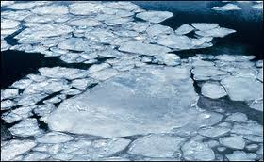
Examples of Physical Properties
Color
Texture
Solubility (whether something dissolves)
Mass
Density
Boiling point
Melting point
Hardness
Malleability (whether it changes shape easily)

Slide 9
Chemical Property
The way a substance reacts with others to form new substances
  CHANGES the composition of the substance

Slide 10


Examples of Chemical Properties
Flammability
Toxicity
Reactivity
Corrosiveness

Slide 11
Name That Property!!

Slide 12
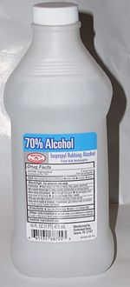
#1
The boiling point of a certain alcohol is 75 degrees Celsius
Physical

Slide 13
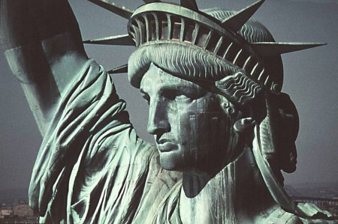
#2
Copper forms green copper carbonate when in contact with moist air
Chemical

Slide 14

#3
Table salt dissolves in water
Physical

Slide 15
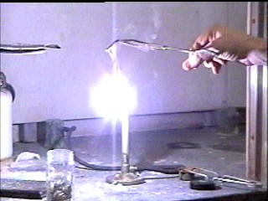
#4
Magnesium burns brightly when ignited
Chemical

Slide 16
#5
Iron is more dense than aluminum
Physical

Slide 17
WHITE BOARD
DOOR
Jeremy C.
Kris
Ashley
U’nyece
Junelie
Lewis
Edith
Mia
Aaryan
Carlos
Anita
Jadia
Kyeshon
Nerin
Alannis
Jabreil
Colby
Katie
Victor
Jeremy M.
Chris
Emely
Lateef

Slide 18
WHITE BOARD
DOOR
Andrew
Madelaine
Dion
Cindy
Gerson
Alysia
Alex
Adalberto
Raycily
Kevin
Luz
Jose
Elina
Daniel
Gabriela
Desiree
Mason
Chanel
Cesar
Niashai
Destiny

Slide 19
WHITE BOARD
DOOR
Edwin
Yosayra
Erick
Iranyi
Jaylene
Junior
Camila
Daniela
Adel
Keyshawn
Felicia
Carlos
Bryana
Chris
Kiara
Freile
Rachel
Carina
Audreys
Elvis
Kevin
Star

Slide 20
2 people you work well with and want to sit with (and WHY)
2 people you do not work well with and shouldn’t sit with (and WHY)
Sit in the front or the back?
Anything else you think I should know?
IF DONE: add these words to your vocab list on page 1: pure substance, element, compound, solution, solute, solvent, emulsion, colloid, suspension, physical property, chemical property, malleability, solubility

